Slide 1
MRI of seeds
NMR and MRI Application in Biotechnology Course

Slide 2
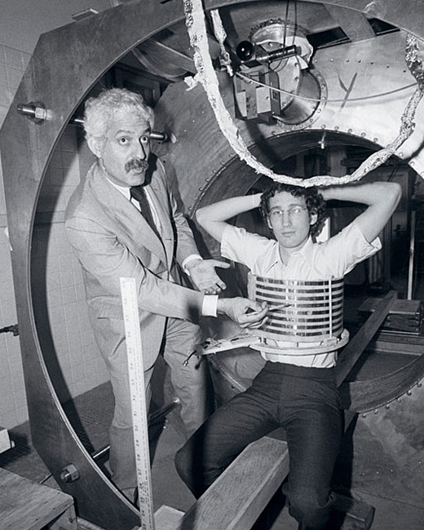
History of MRI
Discovered simultaneously by 2 physicists in 1947:
Felix Boch
Edward Mills Purcell
First clinical images obtained in 1977

Slide 3
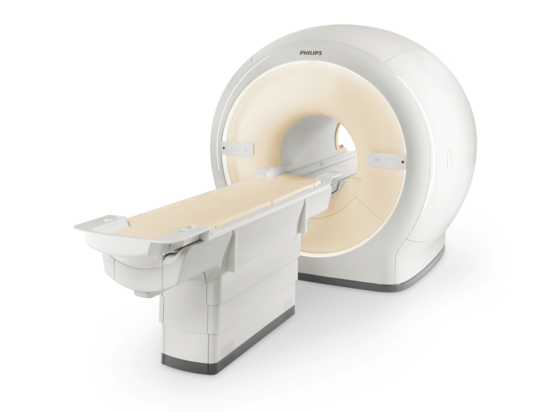
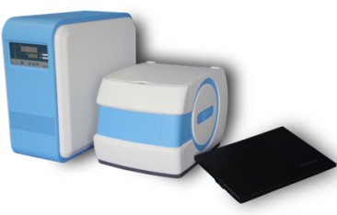
Magnetic Field
Magnetic flux density measured in Tesla (T)
Clinical MRI performed at 1.5-3 T
Earth magnetic field 0.00003T
Low Field MRI 0.08 T

Slide 4
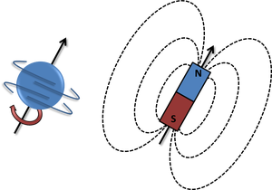
Hydrogen proton
Body is composed by 70% water
MRI relies on the magnetic properties of a hydrogen atom to produces images
H nucleus is composed of a single proton
Spinning charged particle
Produces a magnetic field= magnetic moment

Slide 5
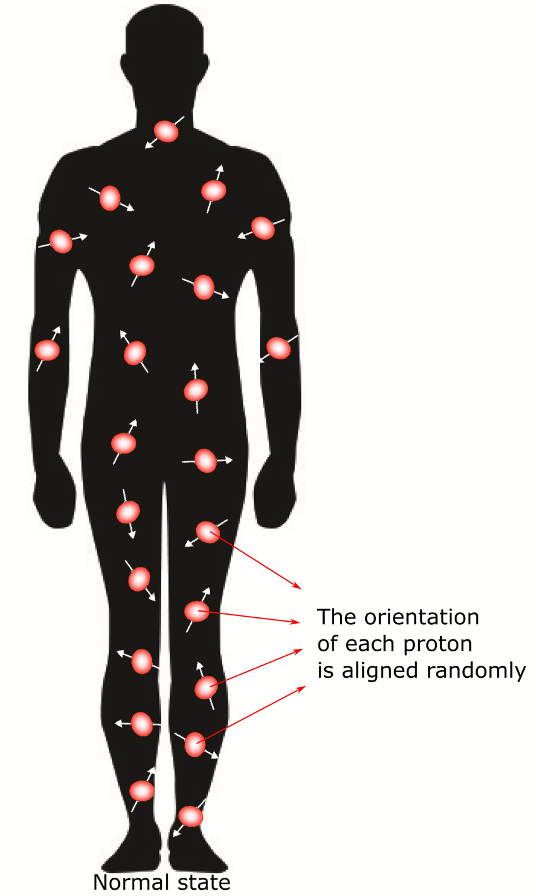
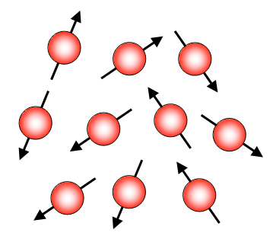
Absence of Magnetic Field
Randomly orientated with no applied magnetic field
There is NO BULK MAGNETIZATION

Slide 6
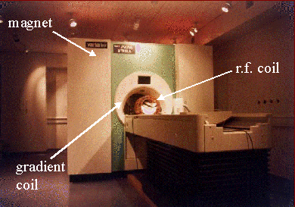
MRI components
Primary Magnet
Gradient Coils
Radiofrequency coils
Computer system

Slide 7
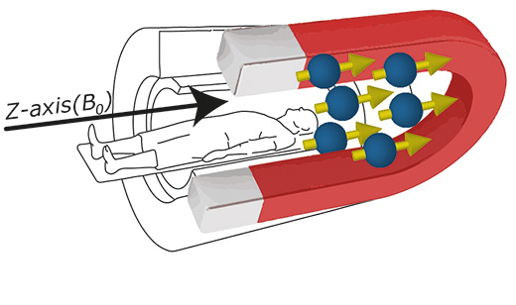
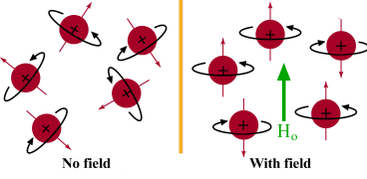
Presence of Magnetic Field- Primary Magnet
Hydrogens align parallel or antiparallel to the magnetic field= longitudinal magnetization
Within the B0 magnetic field, there are more spins aligned with the field (low energy state) than spins aligned against the field (high energy state).
Due to this slight excess of parallel spins, net magnetization has a longitudinal component aligned with B0.

Slide 8
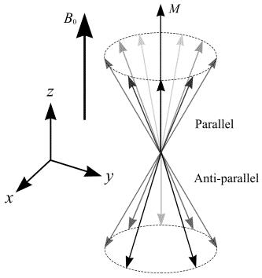
Precession
In the sample the NMR-active nuclei’s magnetic moments are precessing at a field-dependent frequency.
Larmor frequency
ω₀=-γB₀

Slide 9
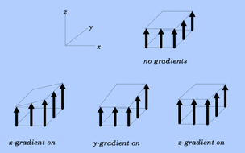
Gradient Coils
Gradients are loops of wire on a cylindrical shell lying just inside the bore of an MR scanner.
When current is passed through these coils a secondary magnetic field is created.
This gradient field slightly distorts the main magnetic field in a predictable pattern, causing the resonance frequency of protons to vary in as a function of position.
The primary function of gradients, therefore, is to allow spatial encoding of the MR signal in the x, y and z axes.

Slide 10
Radiofrequency coils
The radiofrequency coils are used to transmit the radiofrequency pulse and receiving signals in MRI.
A RF pulse is applied (B1) with the same precession frequency with two effects:
1- Some low energy parallel protons flip to a high energy state decreasing longitudinal magnetization
2-Protons precess in phase
z
α
M_{o}
x
x
B₁
M_{xy}
y
y

Slide 11
Relaxation
The return of the equilibrium of the net magnetization is called “relaxation process”
There are two types of relaxation process : T1(spin-lattice relaxation) & T2(spin-spin relaxation)

Slide 12
RF reception
Net magnetic vector = sum of longitudinal and transverse magnetization
Net magnetic vector spirals around z axis with net precession
The changing magnetic moment of the magnetic vector results in free induction decay (FID)
Induces an electrical signal
Signal received by the RF coil in transverse plane and reduces as the signal move to the longitudinal direction (z Axis).

Slide 13
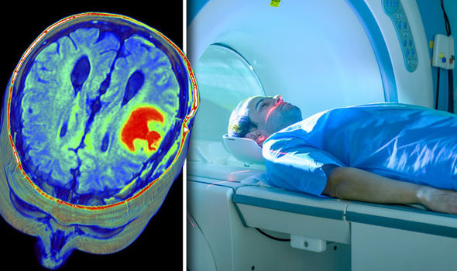
Computer System
The computer system receives the RF signal and performs an analog to digital conversion
The digital MRI signal of the sample is storage in a temporary image space
The digital MRI signal is than sent to an image processor where Fourier Transformation is applied to transform the digital signal into a multi-dimensional image.

Slide 14
Background - MRI of Seeds
The destructive sampling analytical technologies have dominated the plant sciences.
With the growing demand of oil, various metabolic engineering strategies have been developed for manipulation of oil content and composition in vegetative and seed tissues of plant, resulting in a pressure to implement non-invasive measurements of lipids in plants.
The necessity of technical improvements in productivity of established oil crops, in particular oil palm, soybean and sunflower requires a more detailed understanding on how the accumulation of lipids is regulated. This data is only possible if the metabolism and structure of living plant tissue is not disturbed by sampling.

Slide 15
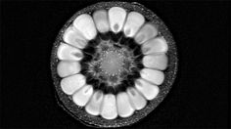
Background- MRI of seeds
Promotion of new candidate plant species as liquid factories, targeting growing environments not used for arable crop production.
Design entirely new cropping systems: to engineer plants to accumulate lipids in their vegetative tissue, rather than only in their seed.
The success of these new strategies will require an approach that allows the understanding of the lipid synthesis and deposition in a living tissue. Such an approach requires non-invasive imaging techniques.
MRI has been proposed as non-invasive, highly informative technology for tracking lipids in planta.

Slide 16
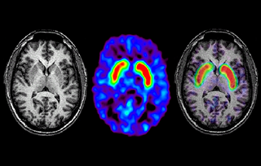
Advantages of MRI
MRI is based on non-ionizing radiation thus is non-harmful to the subject.
MRI generates three dimensional images, overcoming the major drawbacks of both Fourier Transform Infrared Spectroscopy (FTIR) imaging and optimal microscopy.
MRI is the only method which allows for both visualization and quantification of lipid in living plant.

Slide 17
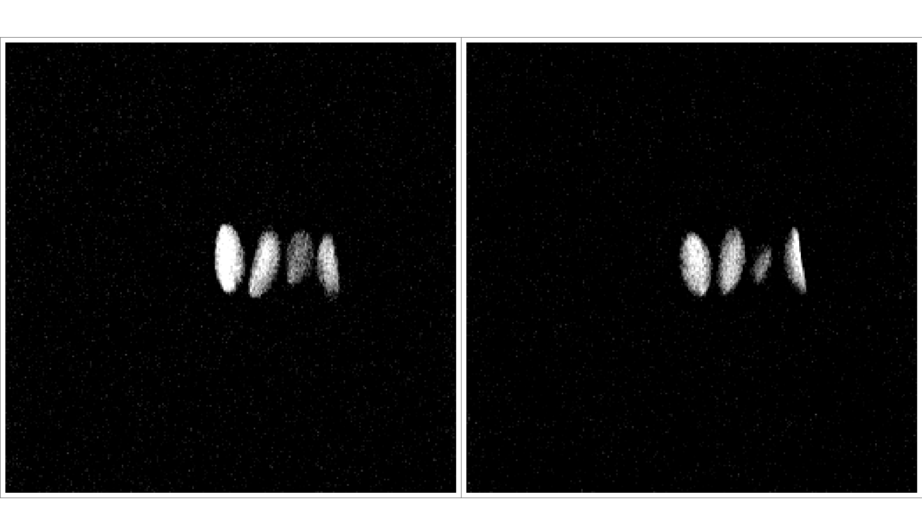
Examples of LF MRI images of seeds
MRI image of Soybean

Slide 18
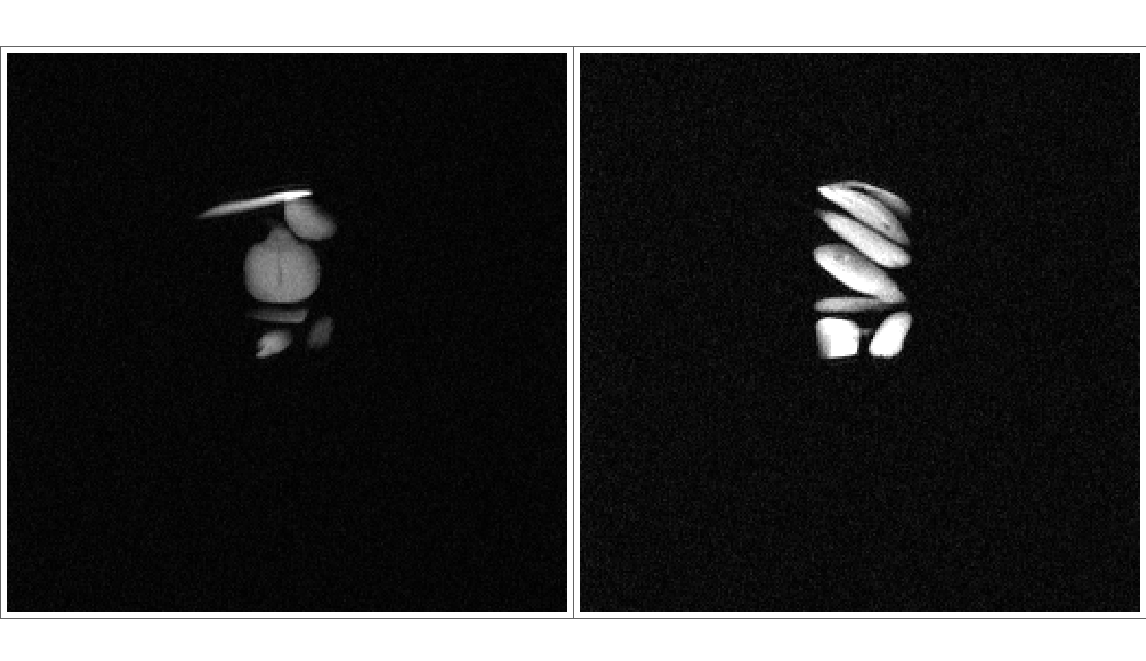
Examples of LF MRI images of seeds
MRI image of Sunflower

Slide 19
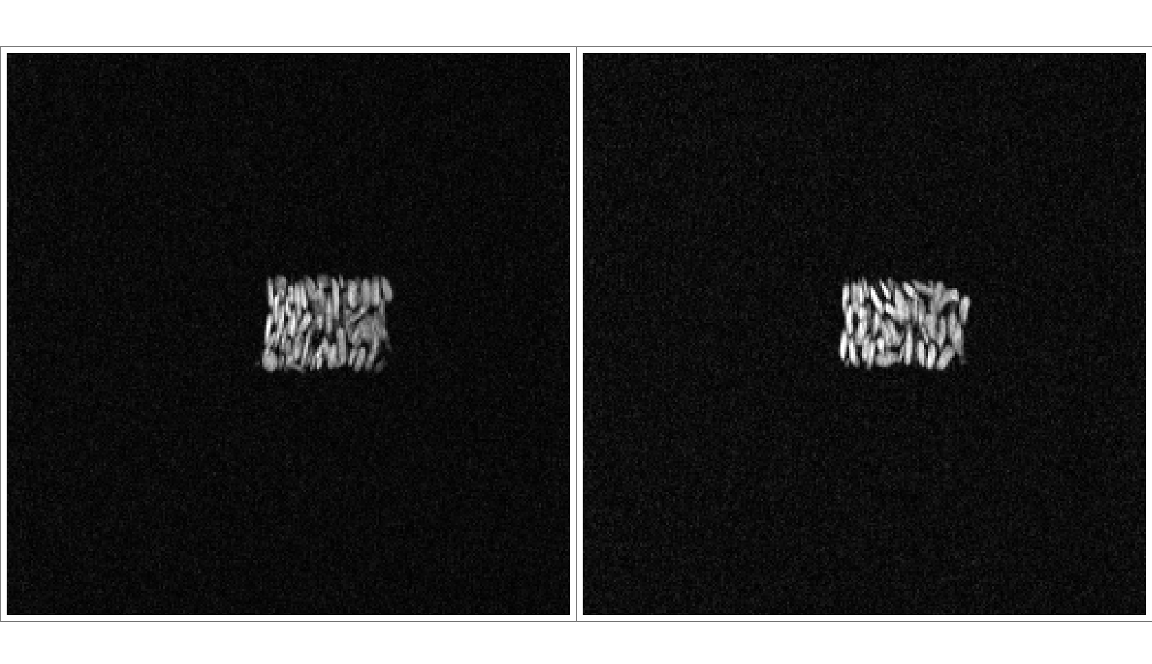
Examples of LF MRI images of seeds
MRI image of Sesame

Slide 20
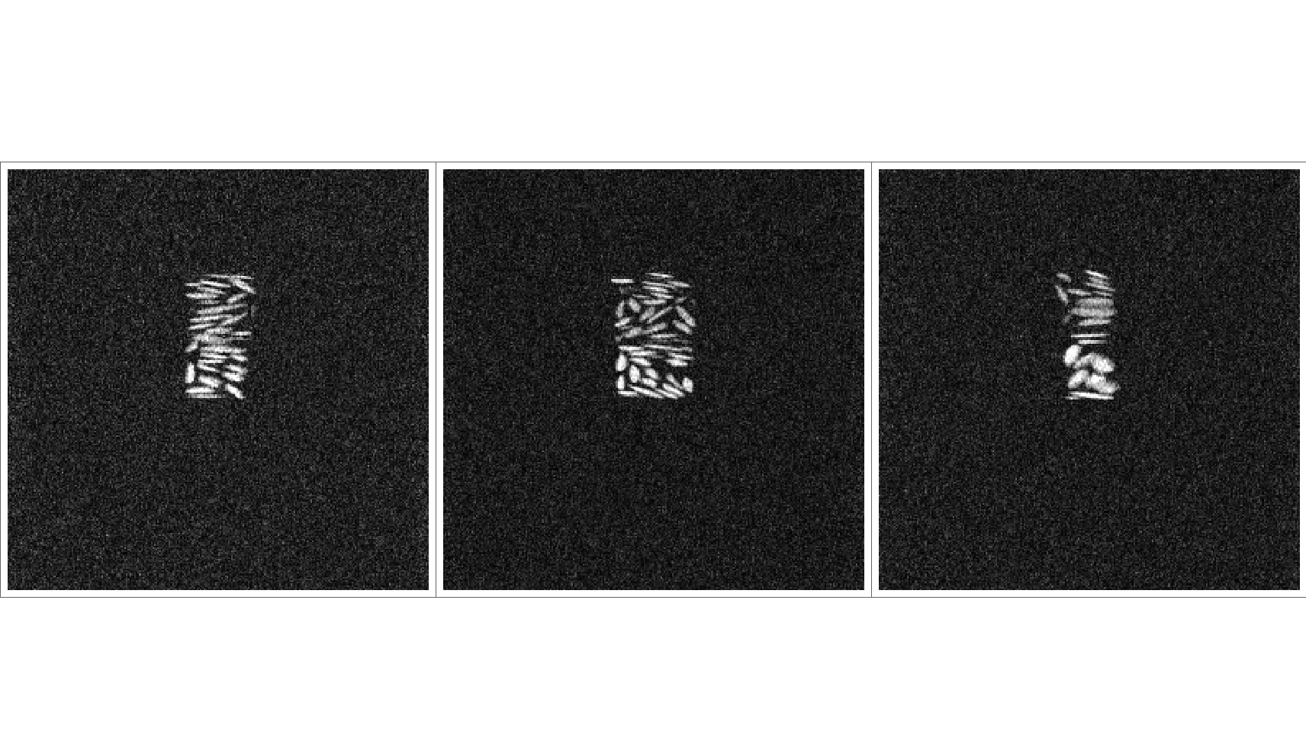
Examples of LF MRI images of seeds
MRI image of Linseed

Slide 21
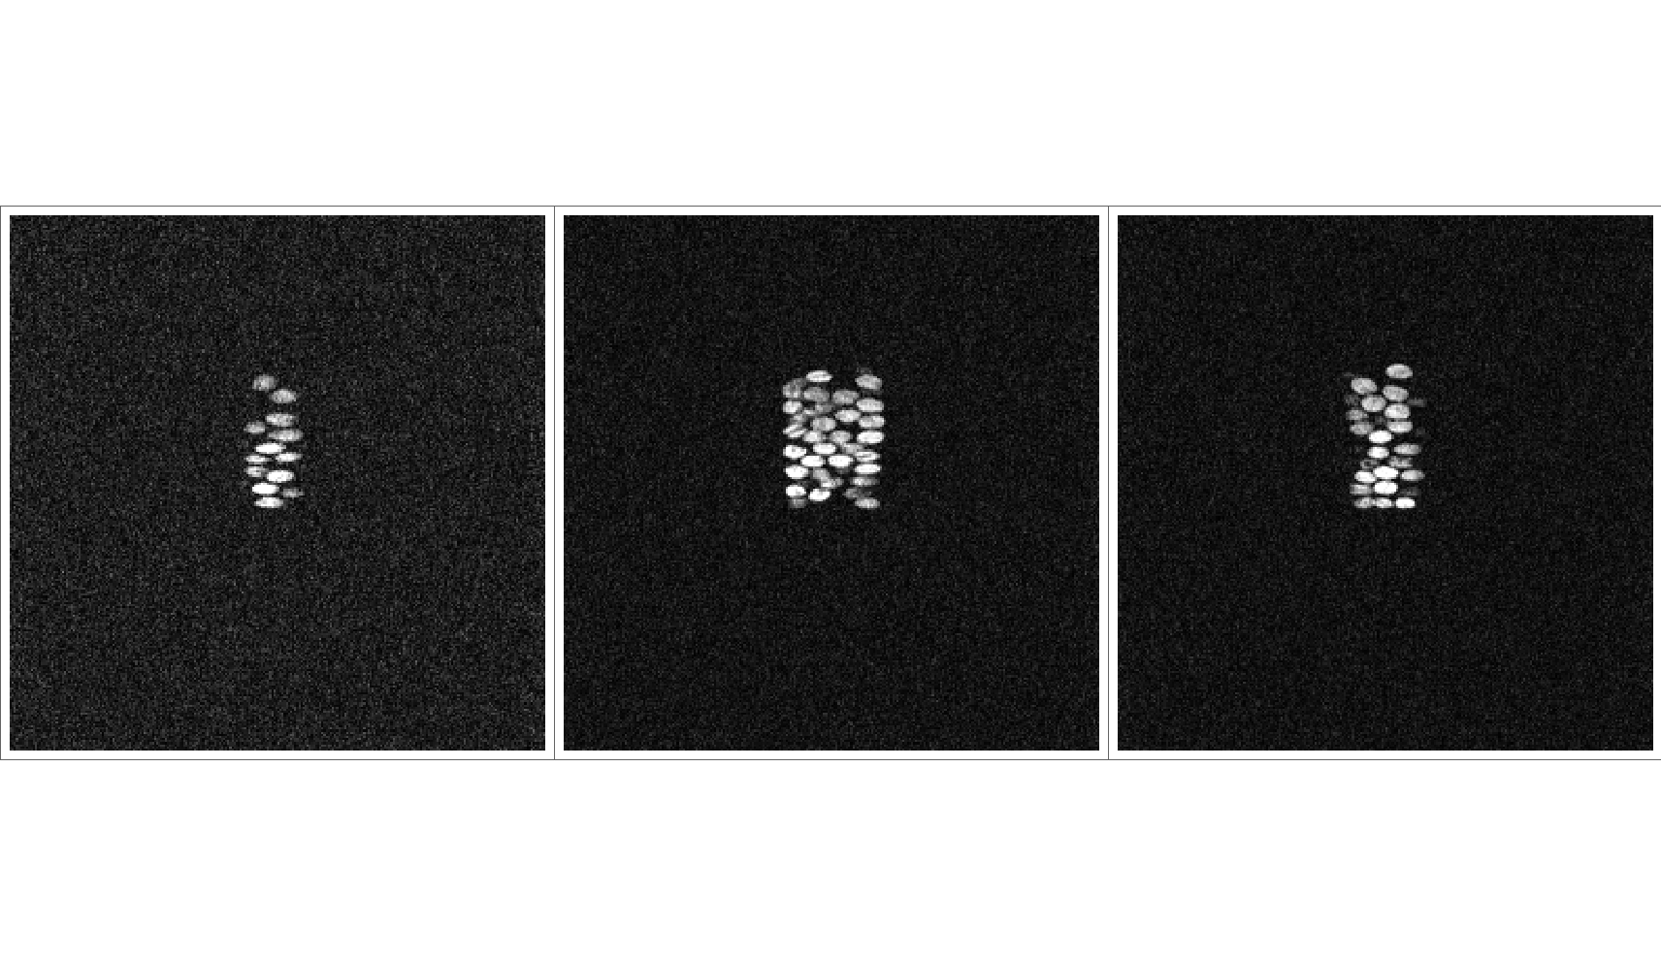
Examples of LF MRI images of seeds
MRI image of Canola Seeds

Slide 22
Contact Information
Prof. Zeev Wiesman: wiesman@bgu.ac.il
Maysa Resende: mteixeiraresende@gmail.com
Prof.Charles Linder: charles.linder@gmail.com
Dr. Janna Abramovich: janna@bgu.ac.il
Shosh Kravchick: kravch@bgu.ac.il
Plant Lipid Biotechnology Lab phone number: 074-7795272

